Slide 1
Lecture 7b: Architecture of MIPS Pipelined Processor
To watch lecture video click link below
Lecture 7b video
To view slides, continue to next slide

Slide 2
Lecture 7b: Architecture of MIPS Pipelined Processor

Slide 3
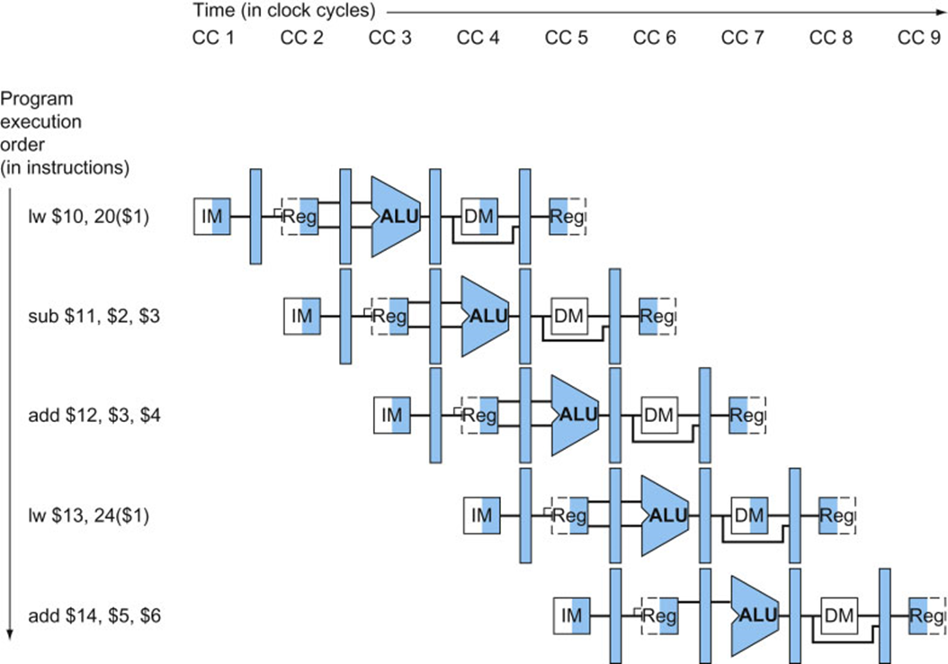
MIPS Pipeline
We have introduced MIPS 5-stage pipelines, the major hardware components used in each stage, as well as pipeline operation principles.
IF / IM
ID / Regs
EX / ALU
MEM/ DM
WB / Regs
Now, how do we modify the datapath and control units too fit into pipelined operation?

Slide 4
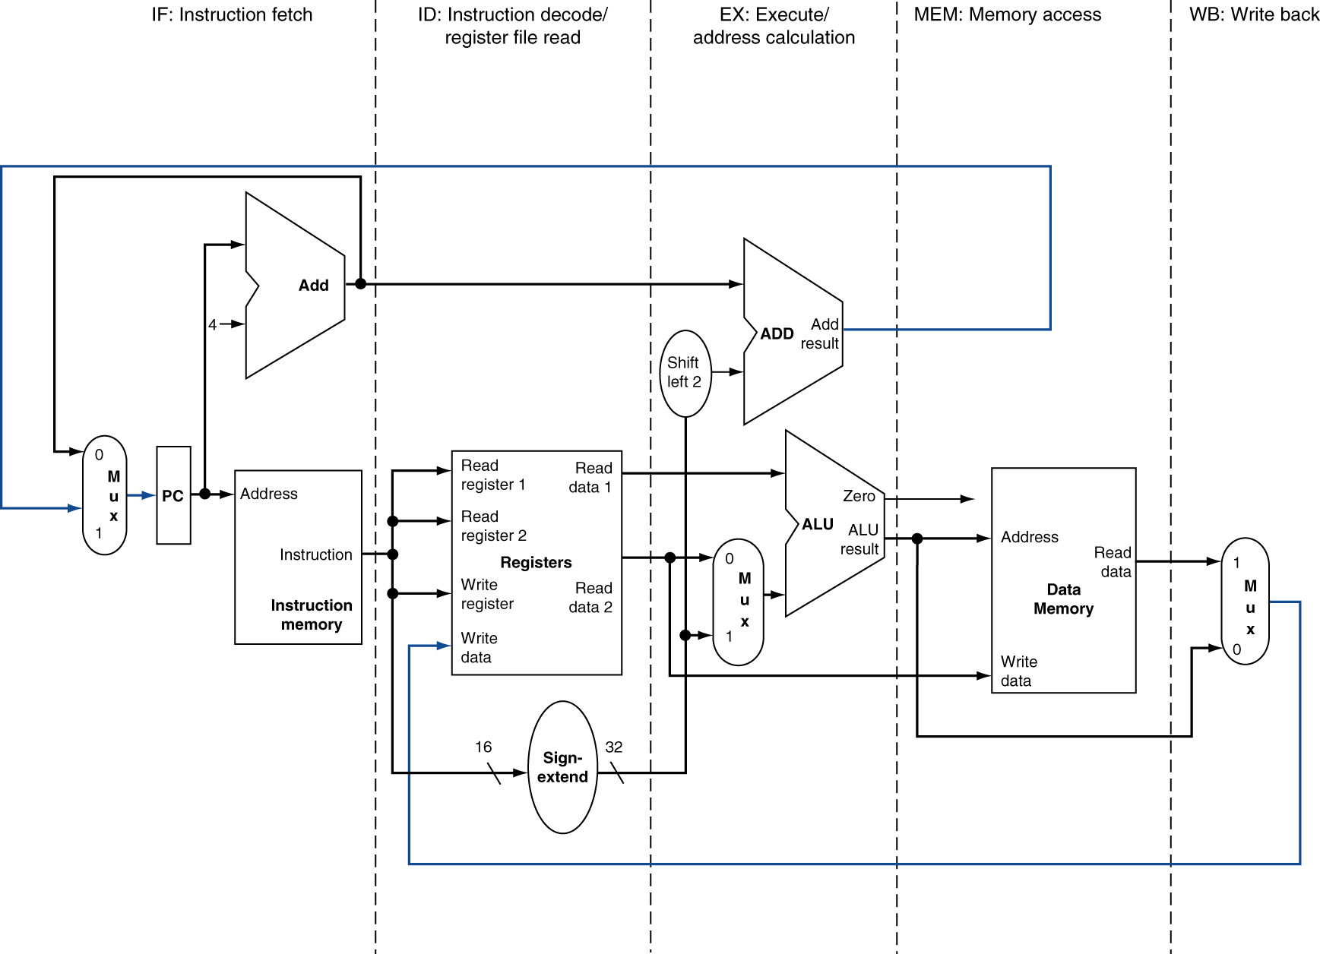
MIPS Pipelined Datapath: 5-stages
MEM
WB

Slide 5
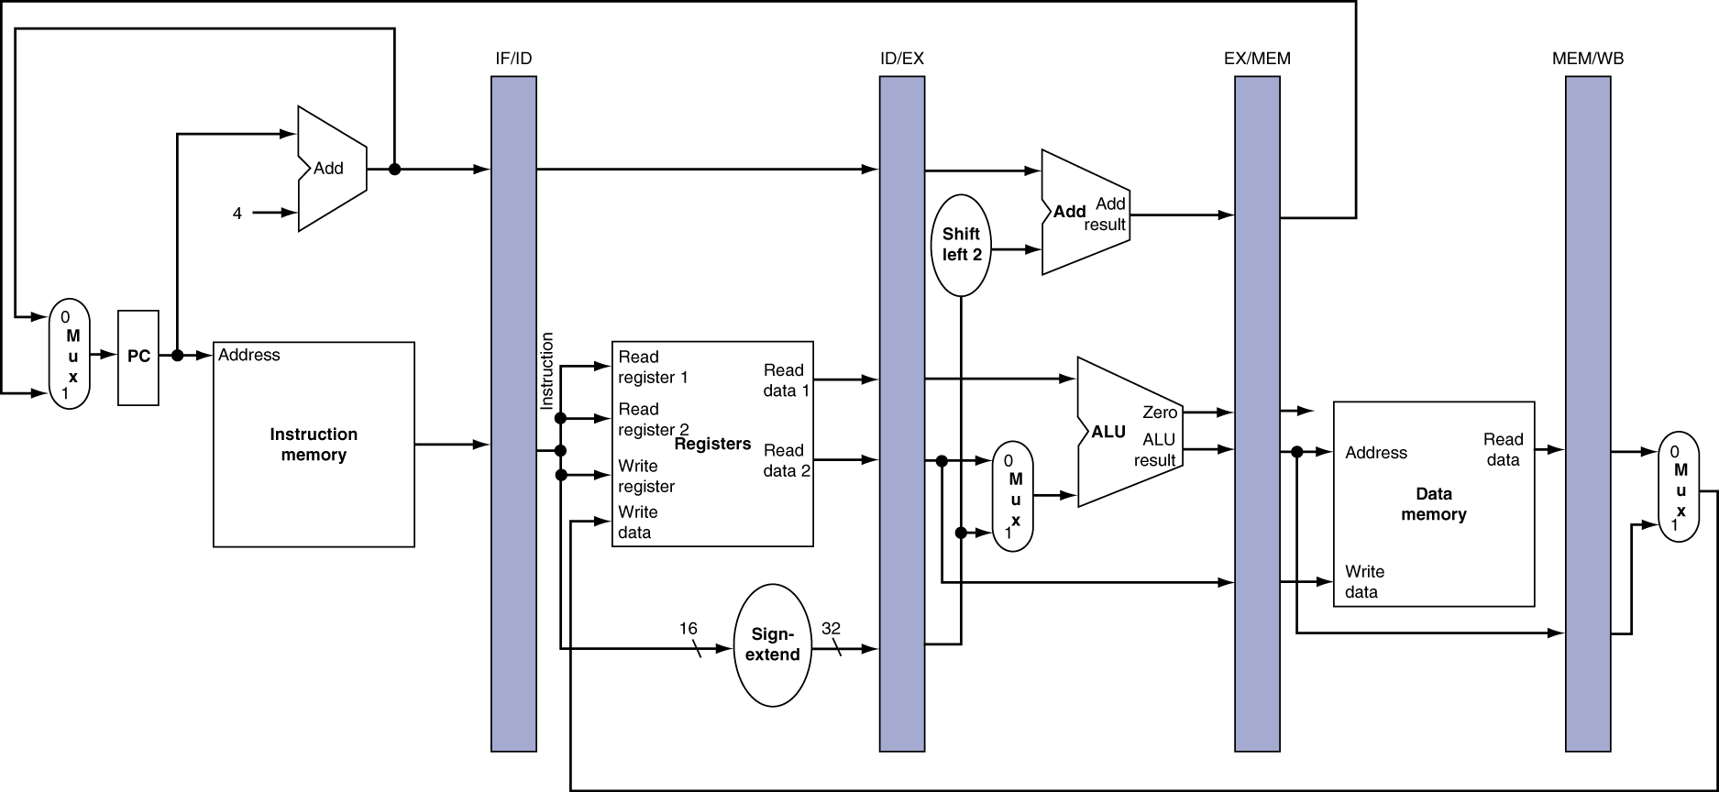
Adding Pipeline Registers
Need registers between stages
To hold information produced in previous cycle

Slide 6
Pipeline Operation
To illustrate pipeline operation, we show cycle-by-cycle flow of instructions through the pipelined datapath
“Single-clock-cycle” diagrams
Shows pipeline usage in a single cycle
Highlight resources used
Compare with multi-cycle pipeline diagram
Graph of operation over time
We’ll look at “single-clock-cycle” diagrams for lw & sw instructions.
Meanwhile we will check if any correction needed for the datapath

Slide 7
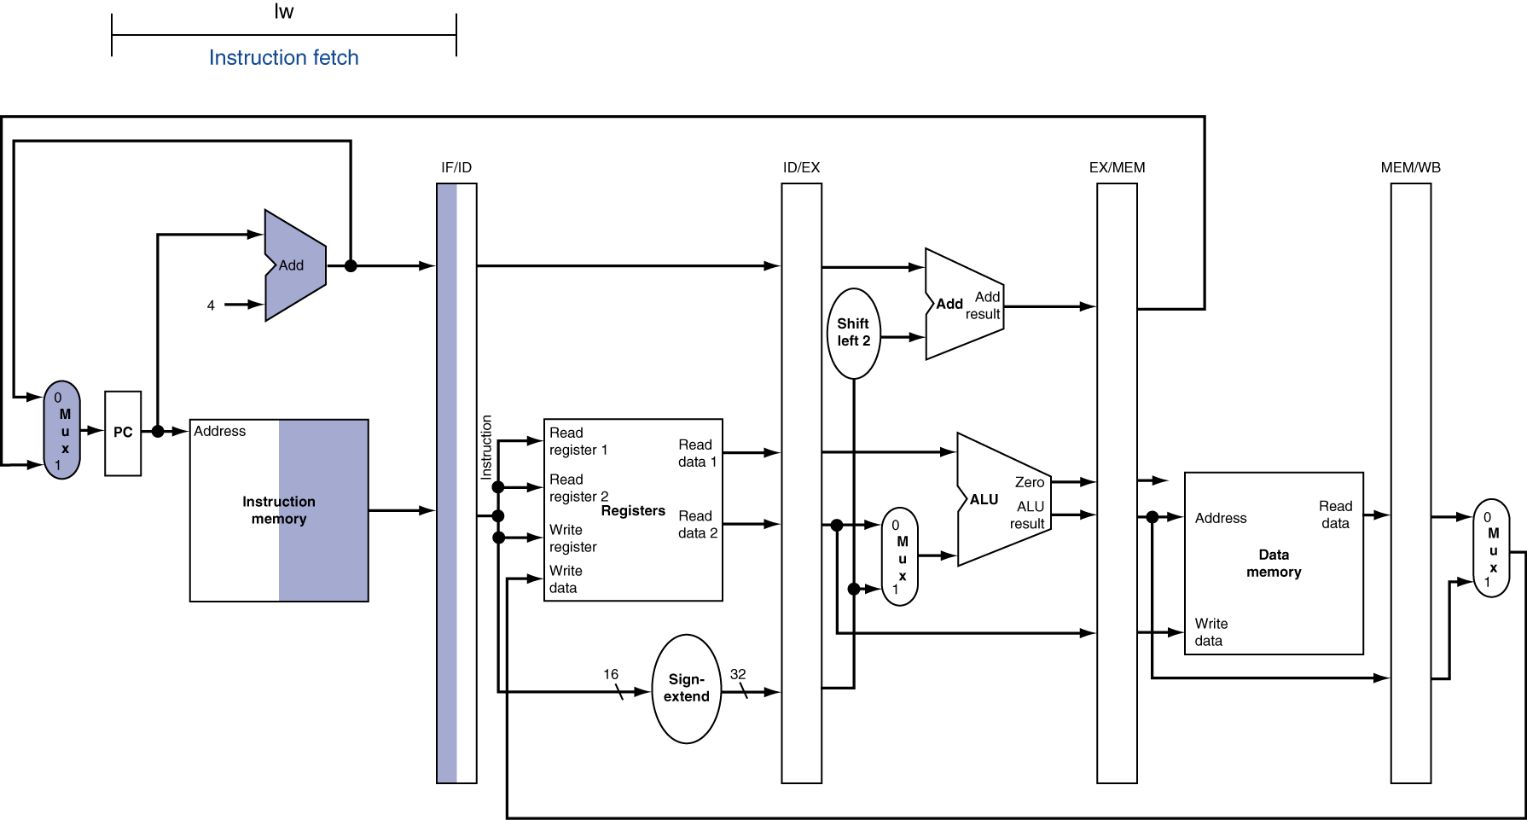
IF (stage 1): for lw, sw, …

Slide 8
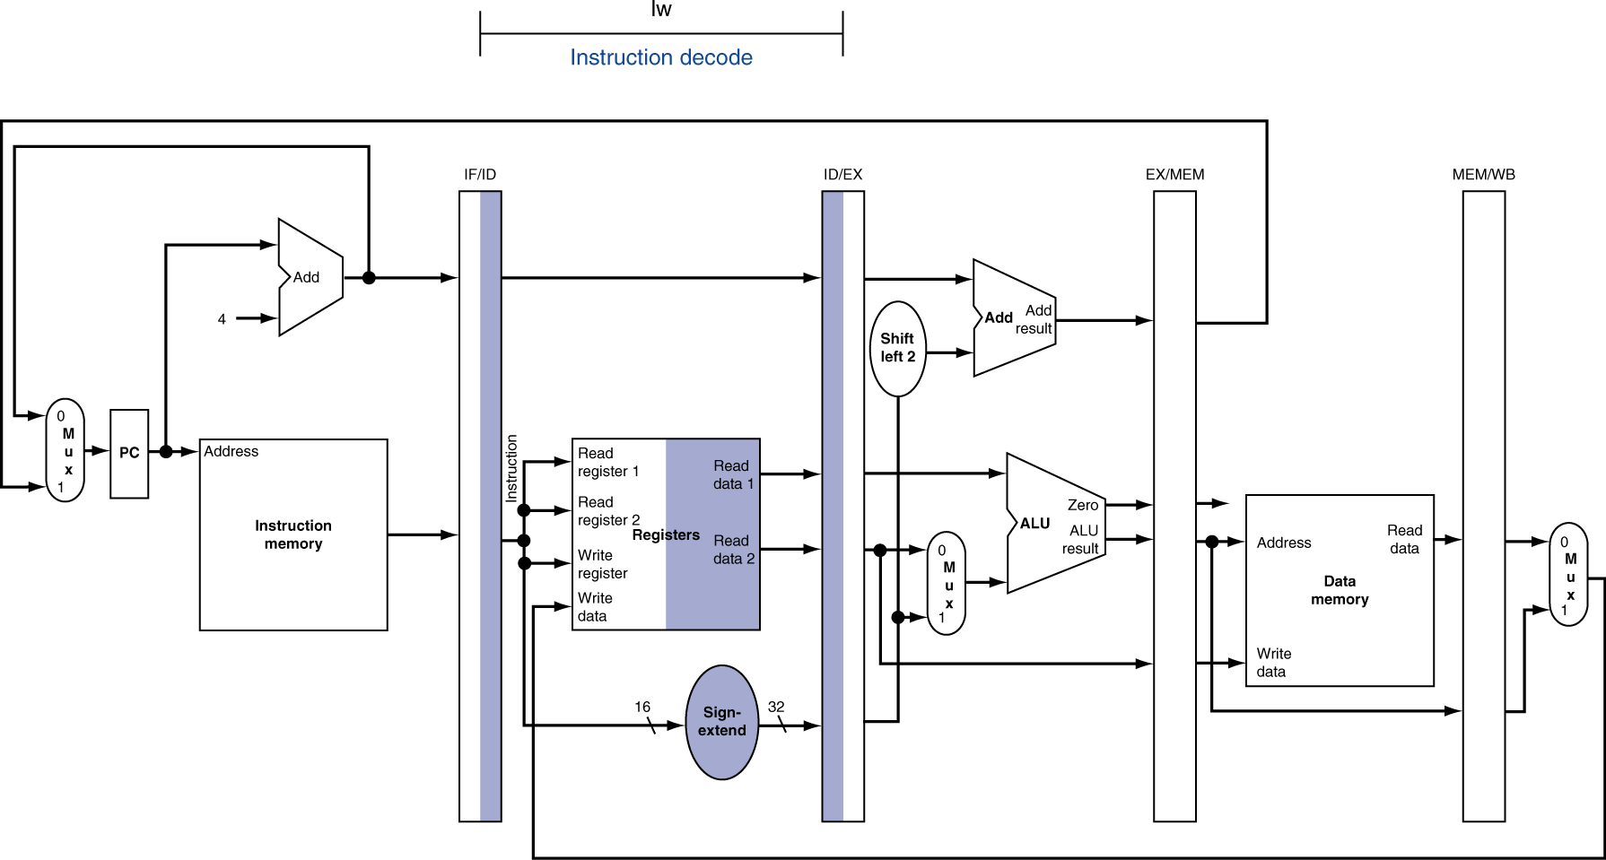
ID (stage 2) for lw, sw, …

Slide 9
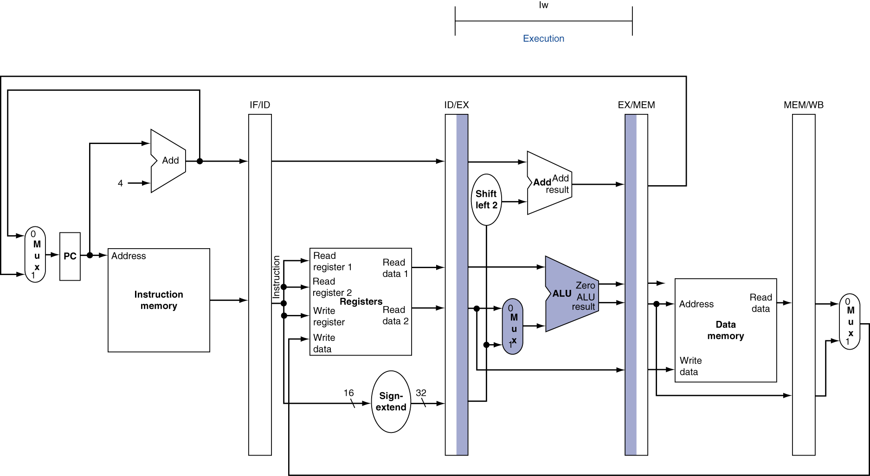
EX (stage 3) for lw
Note: stages 1 & 2 are same for all instructions. Execution may differ starting from stage 3.

Slide 10
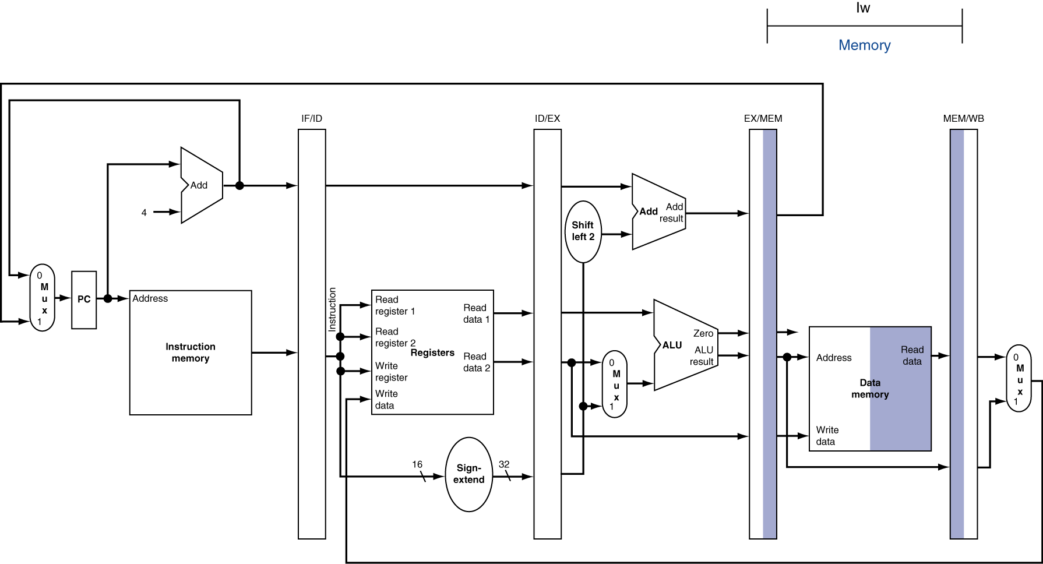
MEM (stage 4) for lw

Slide 11
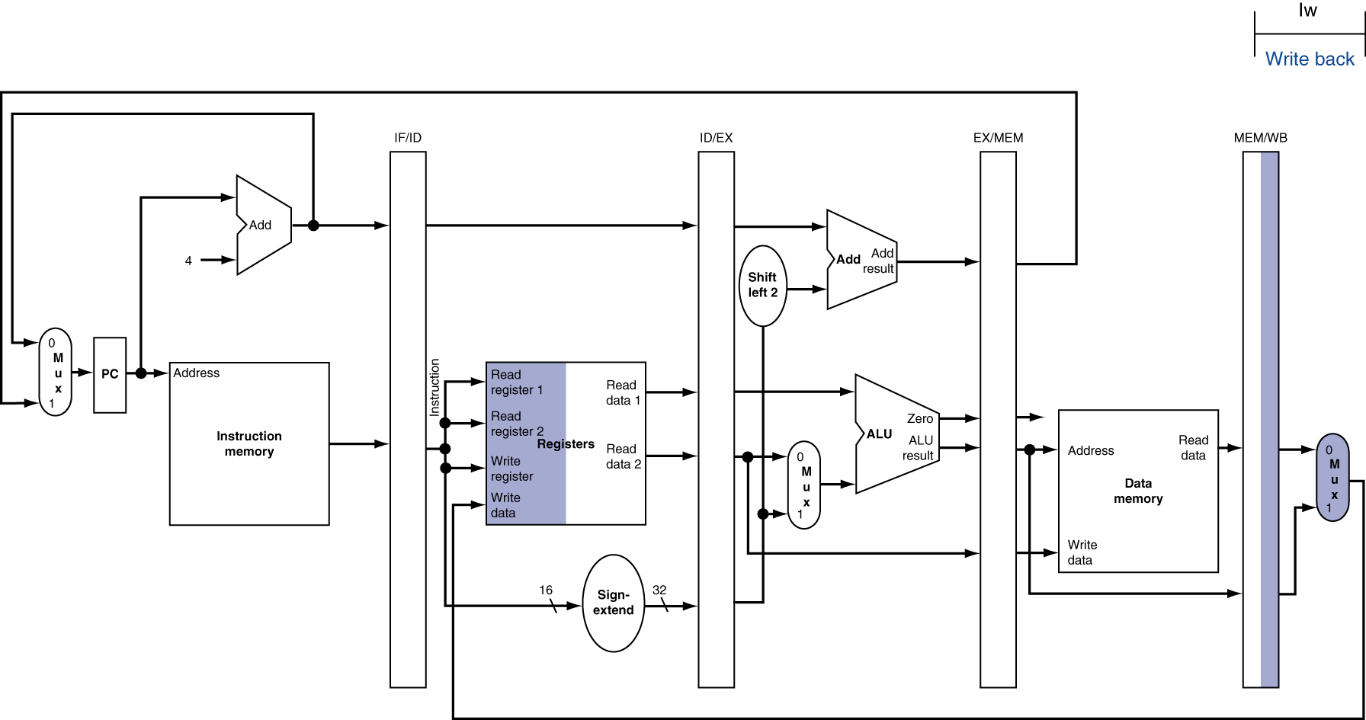
WB (stage 5) for lw
Wrong rd. rd here is from a new instruction, not the lw in WB stage.

Slide 12
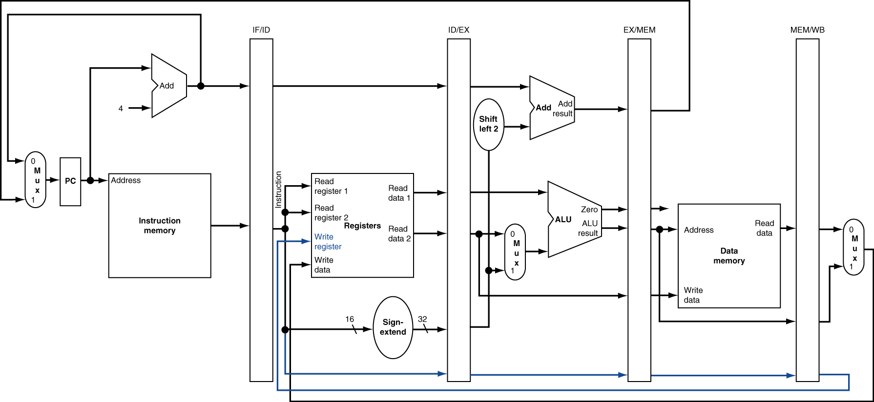
Corrected Pipeline Datapath
The rd # is carried with the instruction along the pipeline stages.

Slide 13

EX (stage 3) for sw
This stage lw and sw still the same.

Slide 14
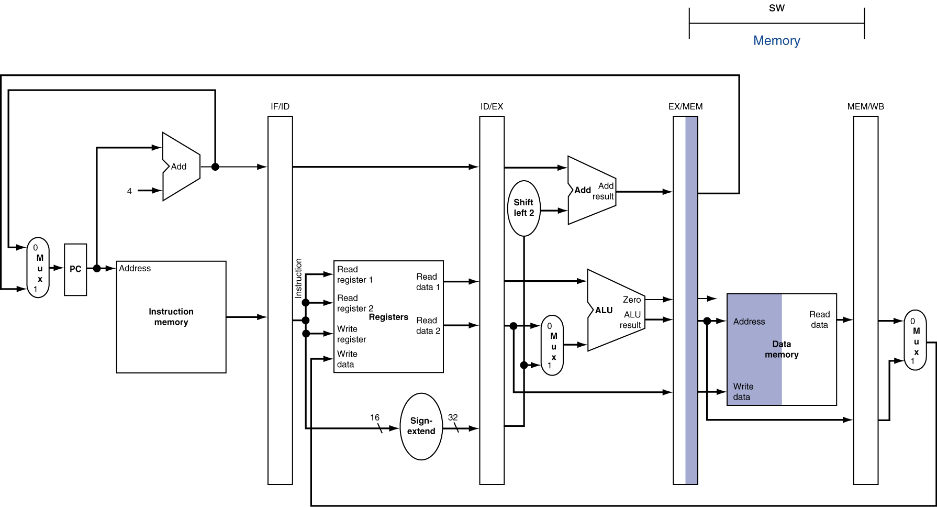
MEM (stage 4) for sw

Slide 15
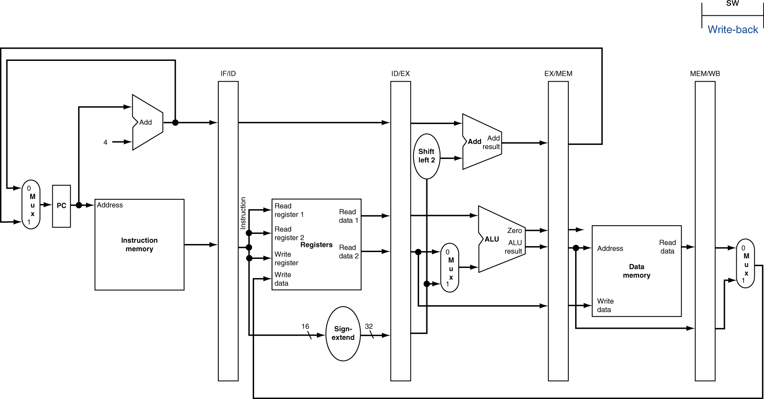
WB (stage 5) for sw
No action in this stage for sw

Slide 16
Pipeline Control
We have 5 stages. At one cycle possibly to have 5 instructions in execution simultaneously.
How do we control multiple instruction executions?
What needs to be controlled in each stage?
Strategy
When an instruction goes to the 2nd stage ID (Instruction Decode and Register Read), main control generates the control signals needed for that instruction
The instruction carries it’s own control signals along the pipeline stages
Design concept (of control) discussed here, details omitted.

Slide 17
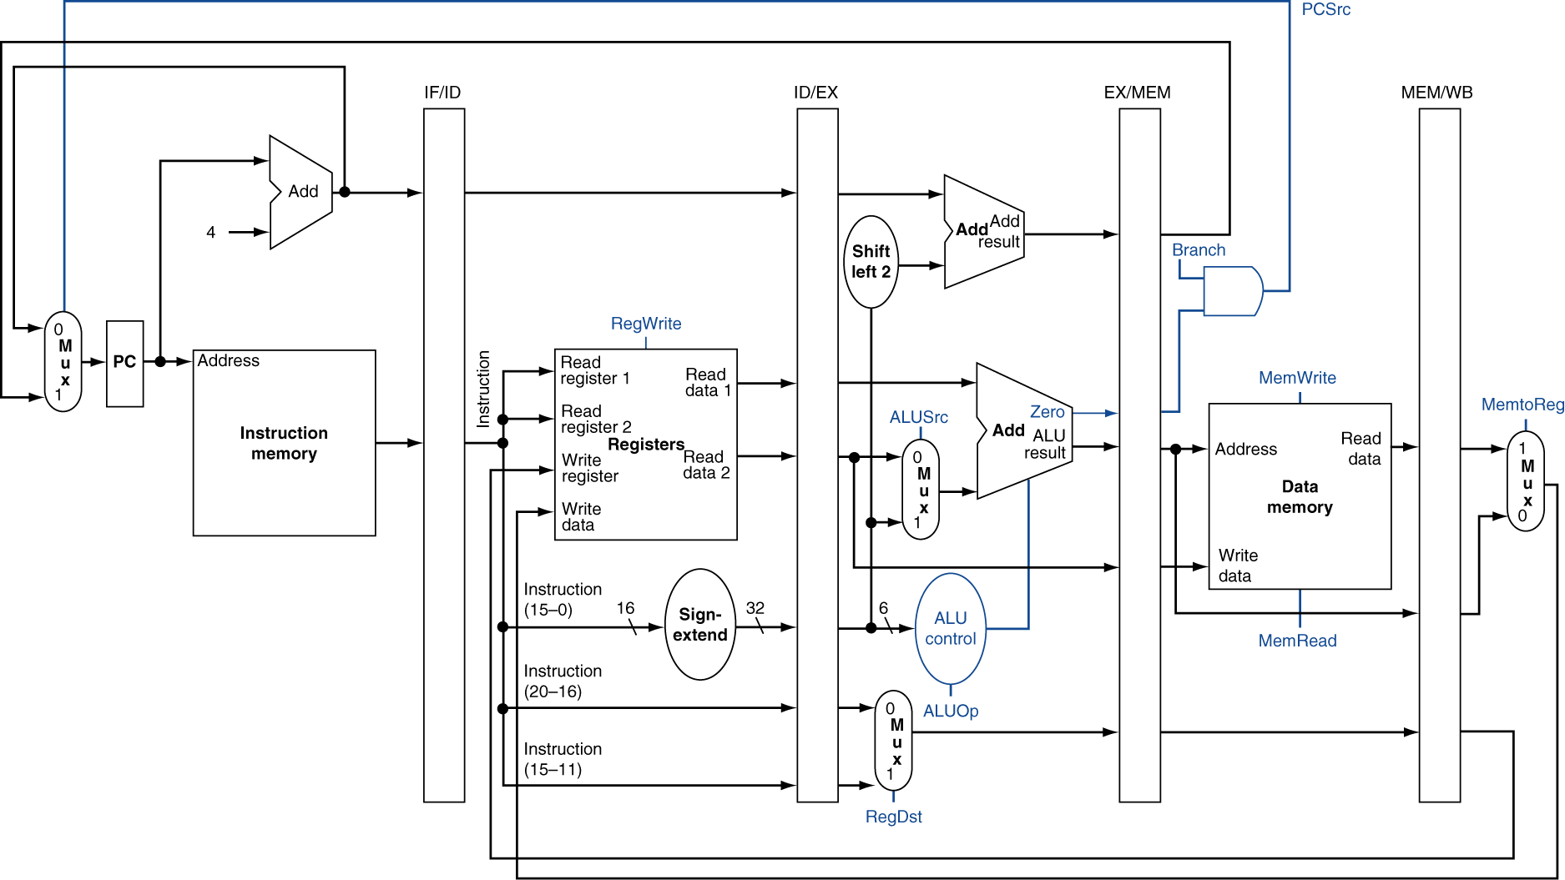
Pipelined Control Signals (Simplified)

Slide 18
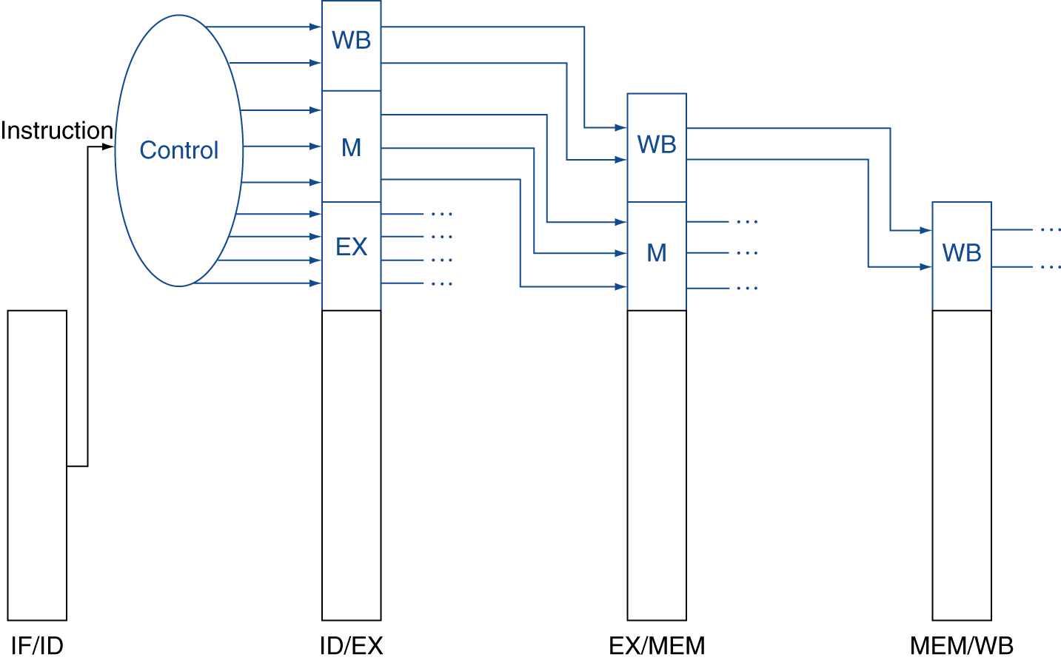
Control Signals: passing along
Control signals derived from instruction
As in single-cycle implementation
Passing along with pipeline stages

Slide 19
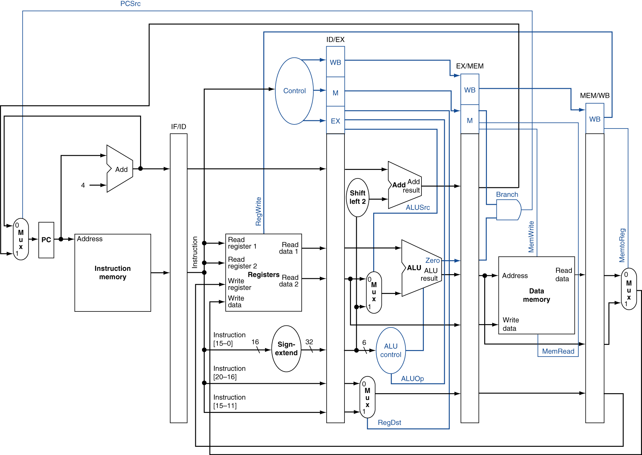
Pipelined Control

Slide 20
Summary
Coverage:
Pipelined datapath
pipeline registers between stages
rd # passing along the pipeline
Pipelined control
Control unit same as sequential
control signals passing along the pipeline

